Slide 1

-Binayak Koirala

Slide 2


Slide 3



Slide 4
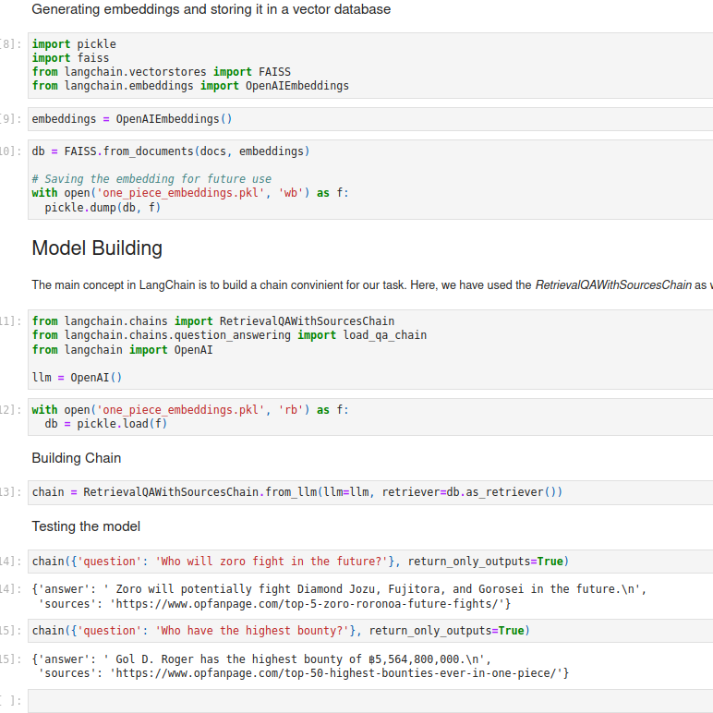

Slide 5
